Slide 1
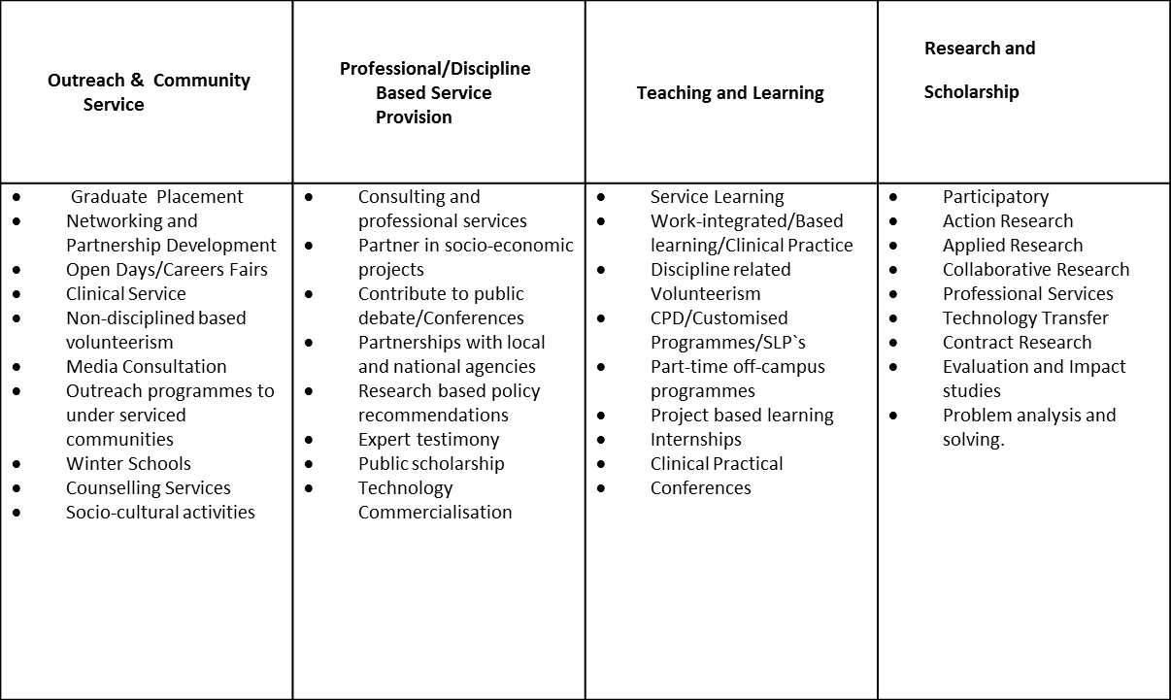
The Nelson Mandela University Engagement Conceptual Framework and Typology

